Slide 1
COMMUNITY BOARD
By, Muhammad Aslam

Slide 2
ASSUMPTIONS ABOUT 311 OPEN DATA NYC
Summer: A lot of noise complaints due to block parties, bars, and clubs.
Winter: No hot water, no heat, and potholes due to a lot of snow. Streets covered in snow; also no salt being thrown on streets.
Fall: A lot of leave falling, causes a lot of trash all over.
Spring: Too much raining can cause puddles, maybe floods.

Slide 3
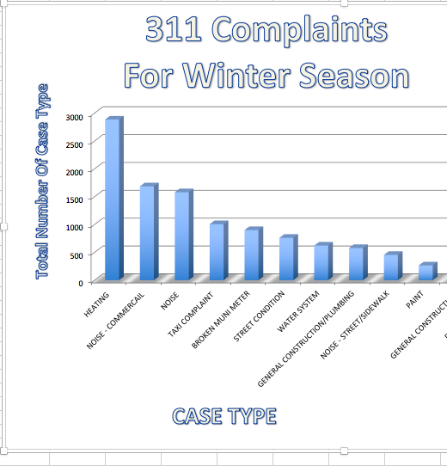

Slide 4
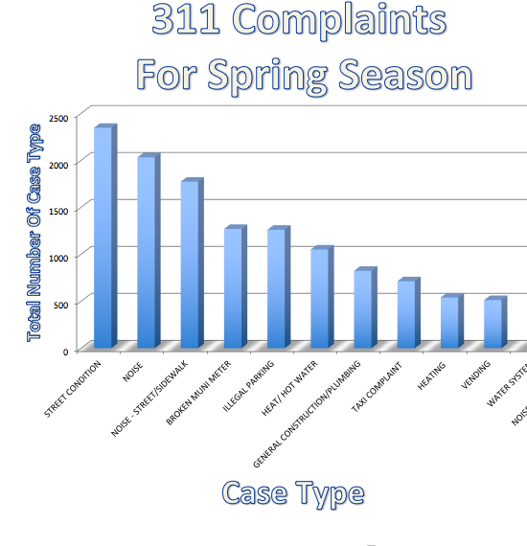

Slide 5
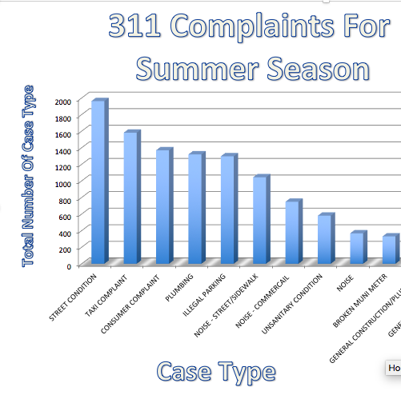

Slide 6

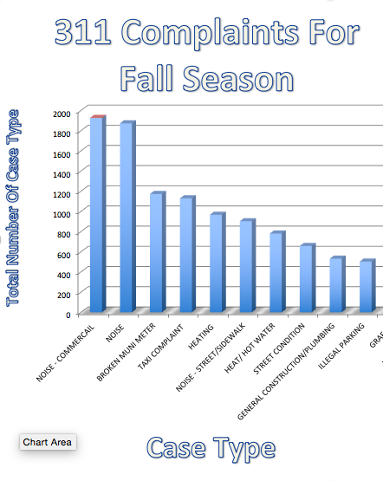

Slide 7
ACCURACY OF ASSUMPTIONS
According to the data that was accomplished by using Scoarta from the 311 NYC Open Data the complaints were accurate as it was predicted before doing the research for the seasons.
There were quiet additional complaints that weren’t expected to appear, but were present in the 311 NYC Open Data top 10 complaints.

Slide 8
ASSUMPTIONS

Slide 9
In winter 2011-2015, the top complaints were related to heat/hot water due to advance technology there might be change in the heat/ hot water complaints.
Broken muni-meter was also, one of the top complaint, it can be fixed by repairing the muni-meter there can certainly be a change in the complaint in the year 2016.
Taxi complaints might show a change after experiencing new types of taxi services

Slide 10
Lets Get Narrower

Slide 11
Heat/Hot Water
MONTH(S) WITH MOST COMPLAINTS ABOUT HEAT/ HOT WATER:
JANUARY
NOVEMBER
DECEMBER
WHY WERE THESE THE MONTH(S) WITH THE MOST COMPLAINTS ABOUT THE HEAT/HOT WATER?
Winter begins on December 21 and lasts until March 21, however the cold starts earlier so that’s why there might be more heat/hot water complaints during November, December, and January.

Slide 12
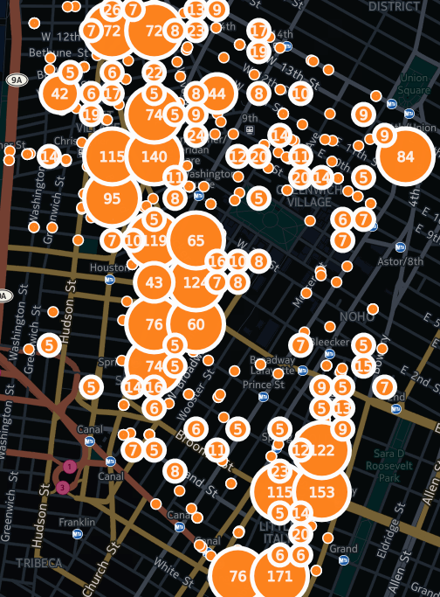
Here are the locations where CB 02 Manhattan is receiving complaints
CLICK HERE:
https://muhammad-aslam.cartodb.com/viz/027df7f2-8cd1-11e5-9632-0ef24382571b/public_map

Slide 13
Rodent Complaints
Months With Most Rodent Complaints:
July
August
September
WHY DURING THE SUMMER?!
Since in the summer people are usually outside partying, eating, etc… the same way rodents want to be out!
Due to the weather conditions

Slide 14
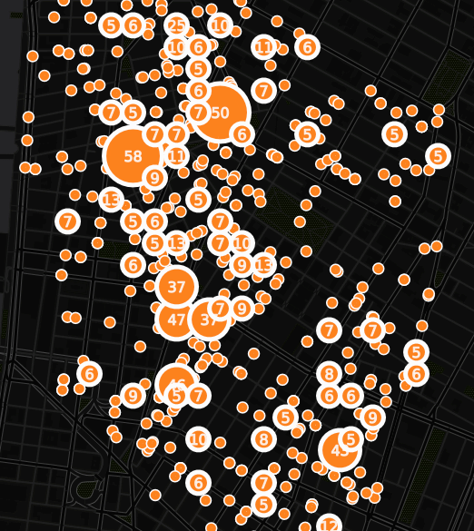
Who’s Calling?
Locations of people who are calling for complaints:
Click Here To Get The Full Preview:
https://muhammad-aslam.cartodb.com/viz/d3d37af2-8c59-11e5-a6ec-0ef7f98ade21/map

Slide 15
Street Conditions
Descriptors:
Pothole
Plate Condition – Noisy
Cave - In
Bad Condition
Failed Street Repair
Defective Hardware
Wear & Tear
Crash Cushion Defect
Unsafe Worksite
Top Five Street Condition Issues:
Pothole
Defective Hardware
Cave – In
Plate Condition – Noisy
Blocked Construction
Assumptions:
During the Summer there were many Blocked – Construction complains, due to the construction going on more often during the summer. Also, complaints about the pothole was throughout the years especially during the winter season because, of snow, which can cause more potholes than there were already before.

Slide 16
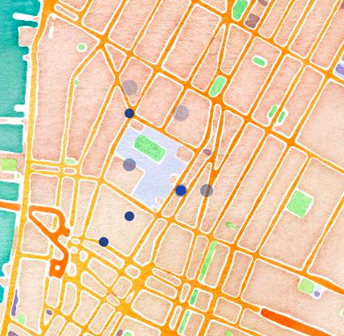
Who’s Calling?
Locations where the complaints were made from the last 60 days
Click Here:
https://muhammad-aslam.cartodb.com/viz/b64c6318-8d71-11e5-ba59-0ef24382571b/map

Slide 17
Noise
Major Hot Spots:
West Houston Street
Soho
Washington Square Park
Why?
Most of the complaints were made nearby the West Houston Street, where are a lot of restaurants and bars, also its included in Soho area as well, which is known very well for shopping stores (Street Mall). Due to high population in these areas, a lot of complaints were made about too much noise.

Slide 18
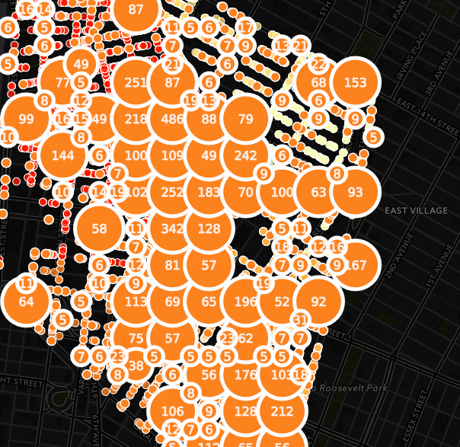
Locations Where The Noise Complaints Were Received
Click Here For The Full Map:
https://muhammad-aslam.cartodb.com/viz/3e30c81c-8a45-11e5-9e7a-0e5db1731f59/map

Slide 19
Illegal Parking
Months With Most Illegal Parking Complaints:
January
April
May
June
July
August
Why During These Months?
Depending on the season some people might park illegally, since in winter it’s cold no one would want to walk, and during April it’s the Spring season; rain might be the reason why people just park anywhere close to their destination.
Who’s Calling? The street where most complaints made was at Spring Street which is where Soho is; a really busy place to be at all times, since there are many shopping places the complaints were made about double parking in the streets.

Slide 20
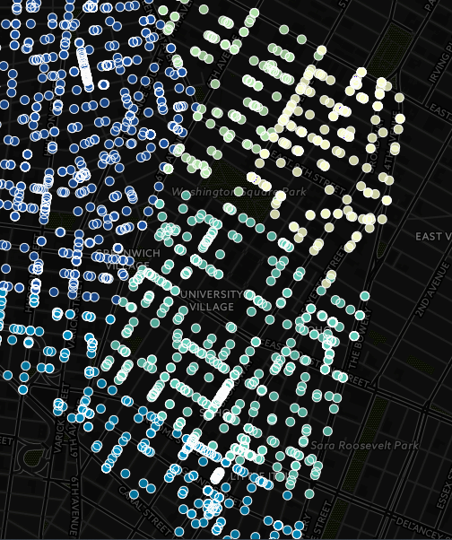
Locations Where Complaints Were Made
Click Here For Full Map Preview:
https://muhammad-aslam.cartodb.com/viz/488edf06-8c52-11e5-8c6c-0ef24382571b/map

